Slide 1
Closest Pair Problem
Lydia Ballard, Sydney Frisbee

Slide 2
What is the Closest Pair Problem?
Closest Pair Problem – a problem that finds the two closest points in a metric space, typically using Euclidean distance, for a set of n points.
We plan to solve this problem with the following algorithms:
Brute Force
Divide and Conquer
Line Sweep
Bee Colony Optimization (BCO)

Slide 3
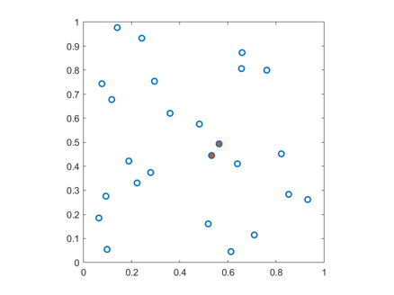
Objectives
How does runtime grow for each algorithm as input size 𝑛 increases
At what input size does Divide & Conquer outperform Brute Force
Which algorithm is best for solving the closest pair problem

Slide 4
Brute Force
Brute force figures out the distance between every pair and stores the minimum distance found.
Time Complexity: Θ(n^2)
We have this algorithm as a baseline due to it being very straightforward

Slide 5
Divide and Conquer
Points are recursively divided into smaller groups. Minimum distance is calculated within each group. During the merging step, check for possible closer pairs across the dividing point.
Time complexity: Θ (n log n)
Reduces the time complexity compared to just brute force, so it is better for more data
More complex to understand and implement

Slide 6
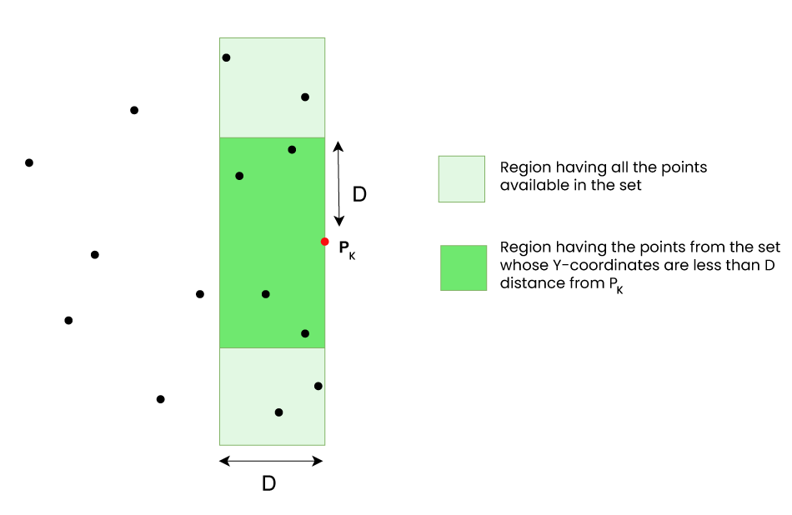
Line Sweep
Line Sweep algorithm first sorts all points by x-coordinate and then processes them from left to right using a sweep line.
Time Complexity: Θ(n log n)
We have this algorithm because it is a specialized algorithm and is useful for comparisons with general algorithms

Slide 7
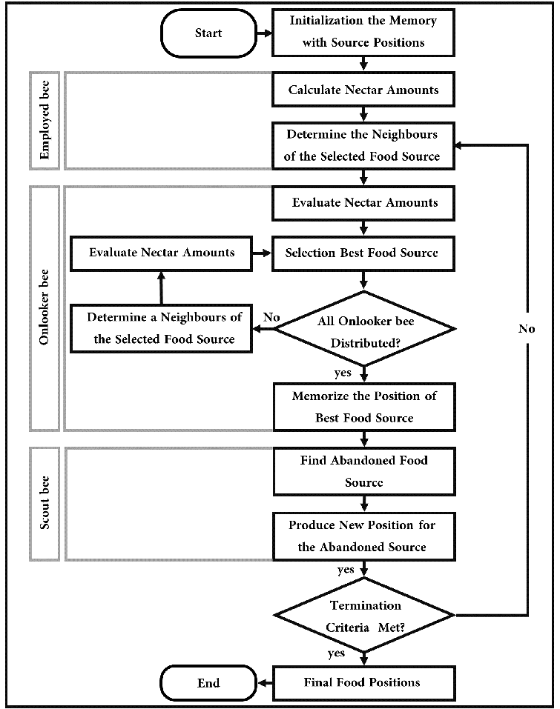
Bee Colony Optimization
Employed Bees: takes the current pair and compares it to a neighboring pair, keeping the closer one
Onlooker Bees: computes fitness for pairs and randomly picks a promising pair to attempt to find a closer distance
Scout Bees: determines that if the pair hasn’t improved after a specific number of iterations, then it may be a bad candidate and replaces the pair with a random pair
Time Complexity: Θ (N⋅I)
Heuristic

Slide 8
Experiment Description
Coded in Python
Artificially generated datasets of XY pairs with a size n
n starts at 2 and increases exponentially up to 8192
Runs each algorithm 5 times for each size n
Specifications of Test Computer:
OS: Windows 11
CPU: AMD Ryzen 9 6900HS Creator Edition
GPU: Nvidia GeForce 3050 Laptop
RAM: 32 GB

Slide 9
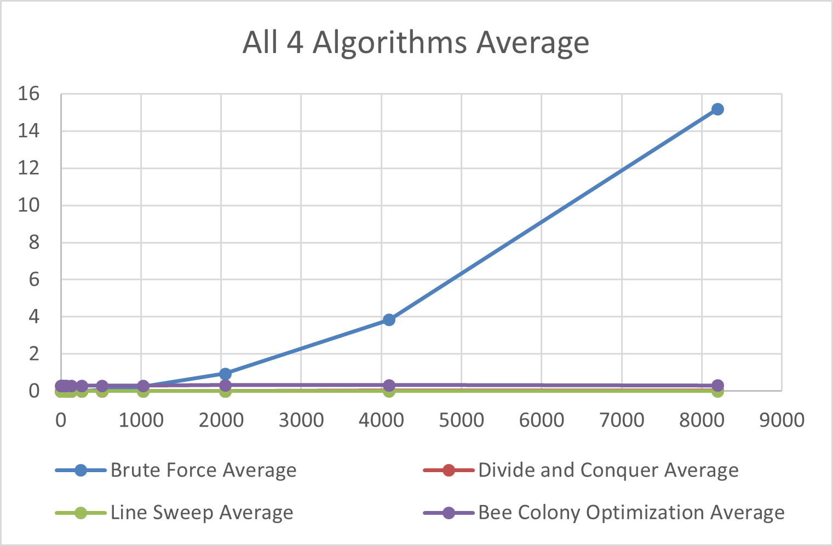
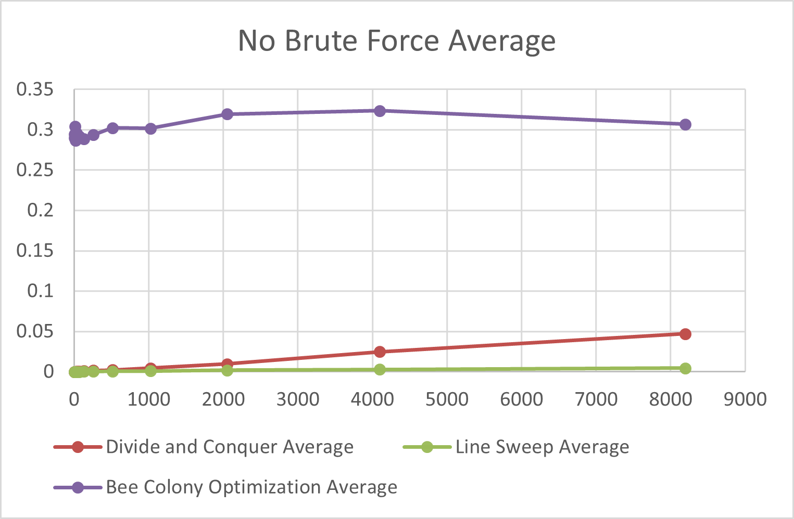
Results

Slide 10
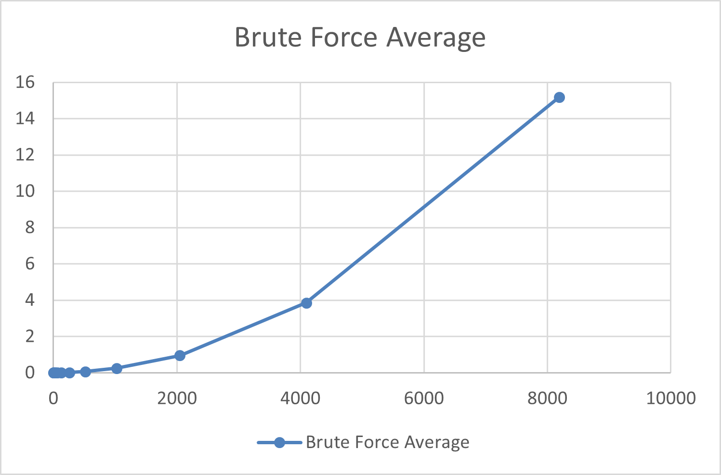
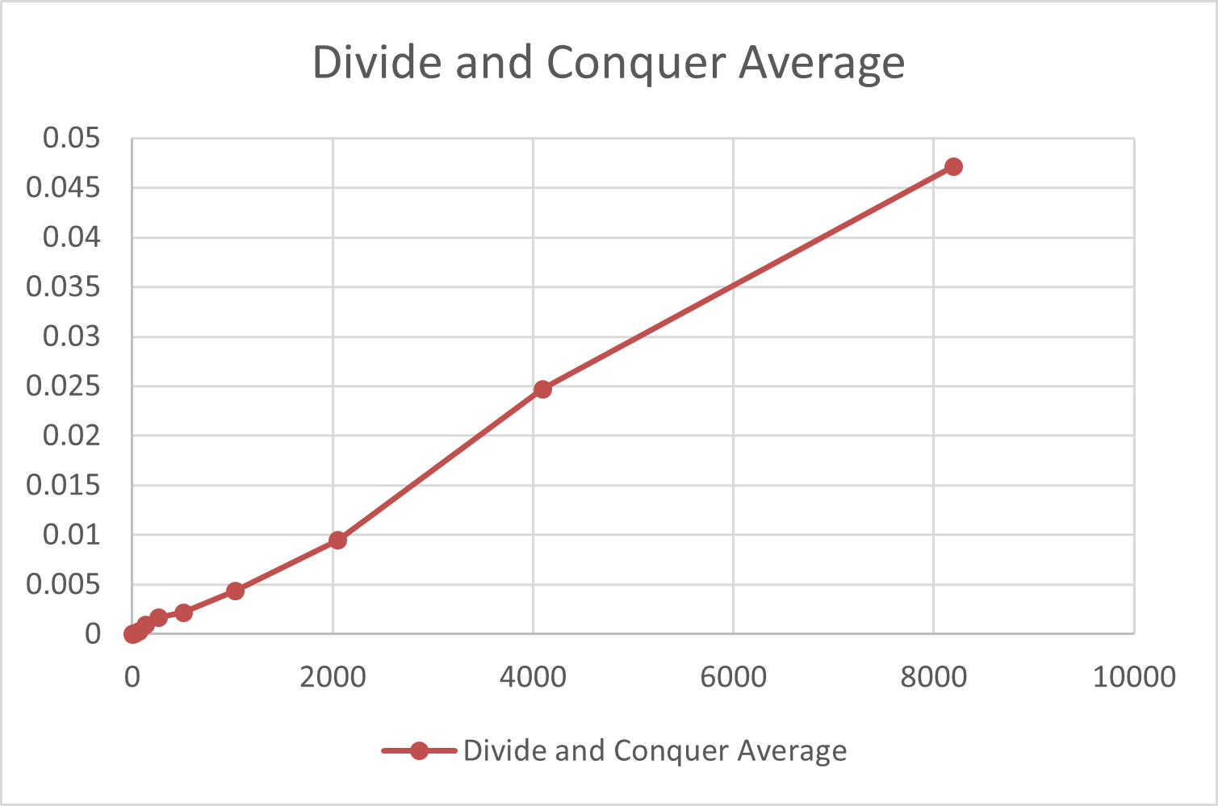
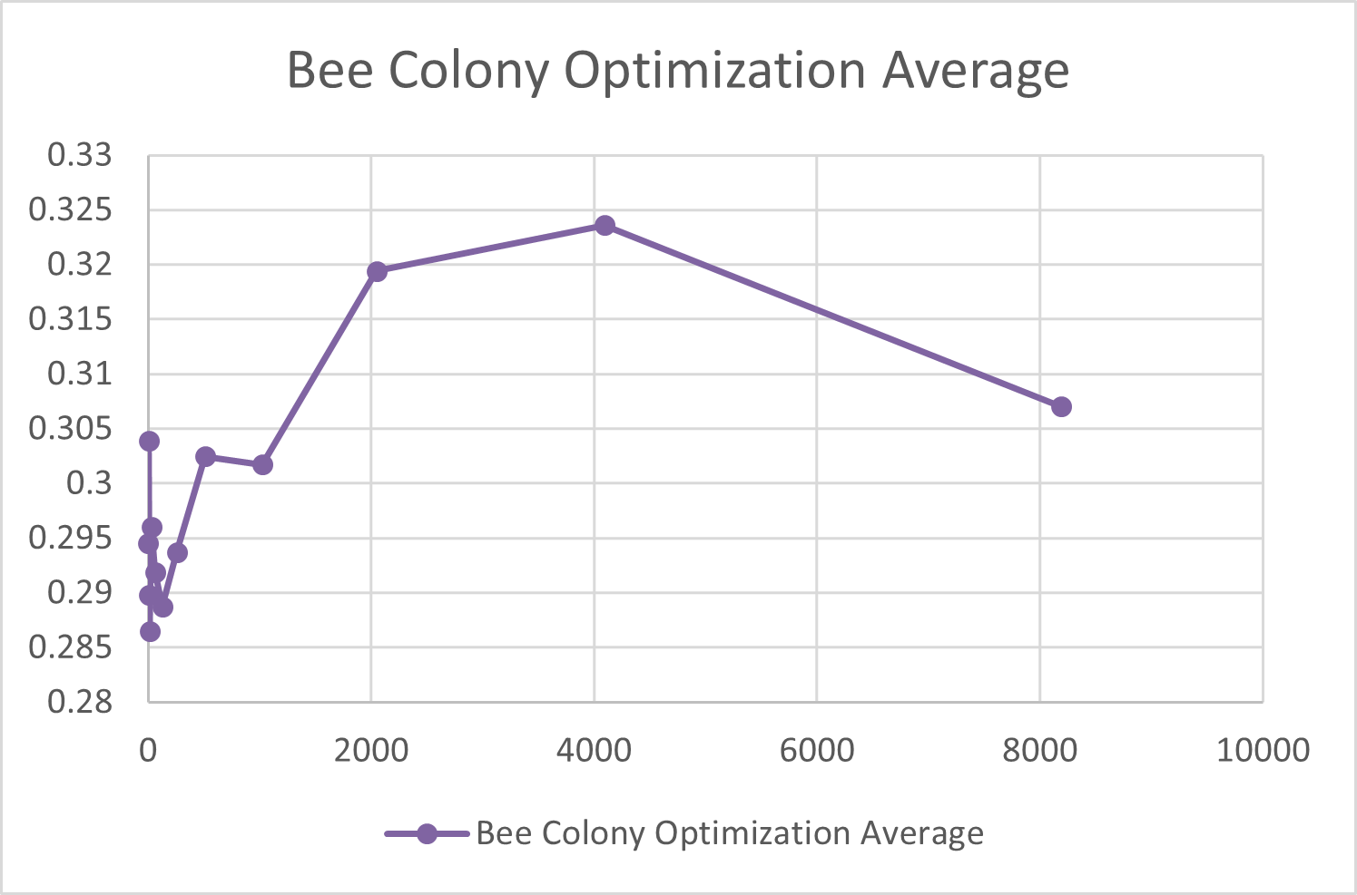
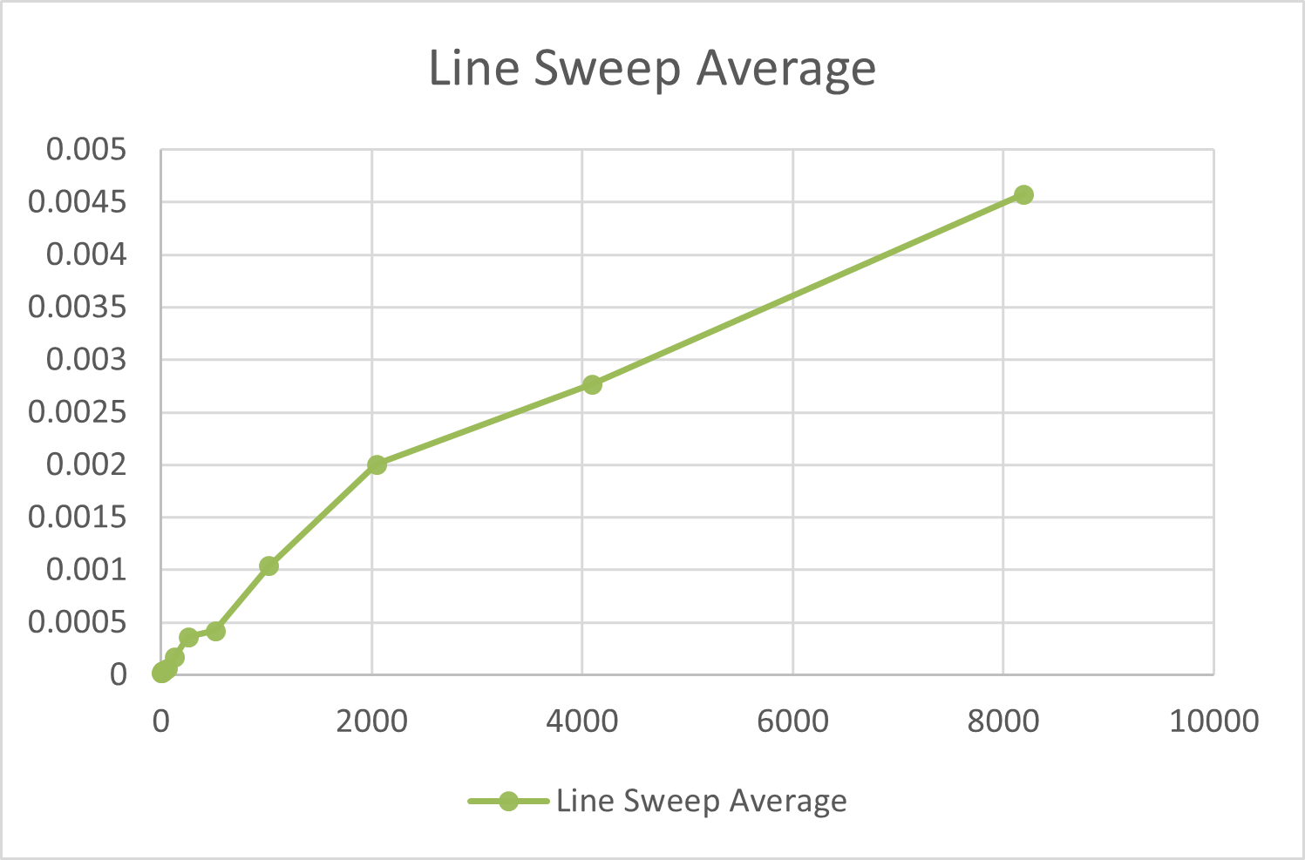

Slide 11
Interpretations
Brute Force is the slowest with Θ(n^2), while Divide and Conquer and Line Sweep are faster with Θ(n log n). BCO is fast but less reliable since it does not always give exact results.
Divide and Conquer becomes much faster than Brute Force as input size increases, showing the impact of better time complexity. Divide and Conquer specifically gets better at n = 16.
With our data, we can conclude that Line Sweep is the most time efficient algorithm to solve the Closest Pair problem.

Slide 12
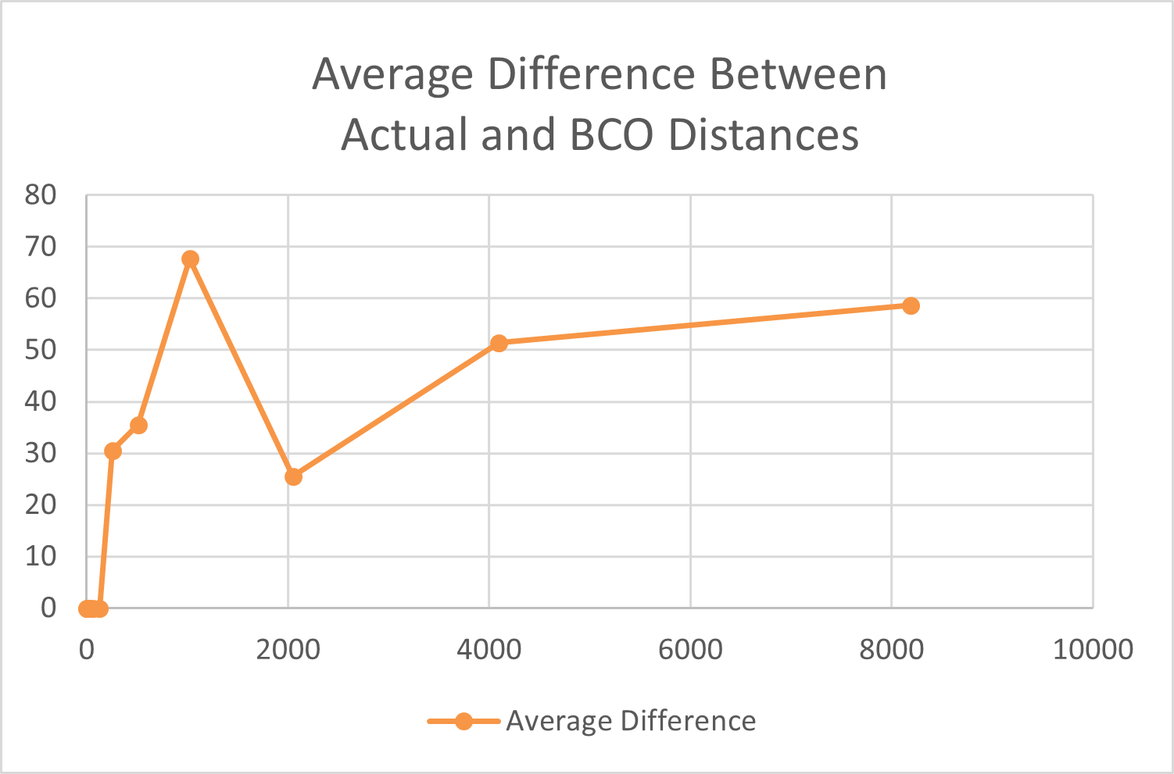
Reflection
Deciding to generate datasets
Seeing the differences between the result BCO got and what the actual closest pair was, and how that changed (n = 256)
Comparing our algorithm results with 3D Closest Pair Algorithms

Slide 13
Sources
“Closest Pair of Points.” GeeksforGeeks, 21 Apr. 2026, https://www.geeksforgeeks.org/dsa/closest-pair-of-points-using-sweep-line-algorithm/
PhABC: A Hybrid Artificial Bee Colony Strategy for Pairwise test suite Generation with Constraints Support - Scientific Figure on ResearchGate. Available from: https://www.researchgate.net/figure/Flowchart-of-the-Artificial-Bee-Colony-algorithm_fig1_337512964
“ChatGPT.” OpenAI, 2025, chat.openai.com/.
- The author(s) acknowledge the utilization of ChatGPT, a language model developed by OpenAI, in the preparation of this assignment. ChatGPT was employed in the following manner(s) within this assignment: code generation in sections of our 4 Python algorithm files.

Slide 14
Closest Pair Problem
Lydia Ballard, Sydney Frisbee

